Slide 1
Blood Bank Management System
IACSD
(Institute for Advanced Computing and Software Development)
Guide:- Milind Arjun
By:- Chandrakant Shelar
Pratik Surwase

Slide 2
Introduction
The main aim of this project is to save lives of people by providing blood. Our project Online Blood Bank system using J2EE is developed so that users can view the information of nearby hospitals, blood banks.
This project is developed by three perspective i.e. hospital, blood bank and donor. We have provided security for authenticated user as new user have to register according to their type of perspective and existing user have to login.

Slide 3
Objectives
To develop a system that provides functions to support donors to view and manage their information conveniently.
To maintain records of blood donors, blood donation information and blood stocks in a centralized database system.
To inform donors of their blood result after their donation.
To support searching, matching and requesting for blood convenient foradministrators.

Slide 4
Technology Used
Front End:-
Angular, Bootstrap, jQuery, HTML CSS etc.
Back End:-
SpringBoot, Hibernate etc.
Database :-
MYSQL.
Server :-
Apache Tomcat.

Slide 5
Modules
Donar:
Person who wants to donate blood.
Blood Donation:
Every blood donation record.
Inventory:
Keeping track on stock various types of blood.
Request:
Requests From seeker is manage.
Blood Bank:
Manages Its inventory and requests.
Seeker:
Person Who needed a blood

Slide 6
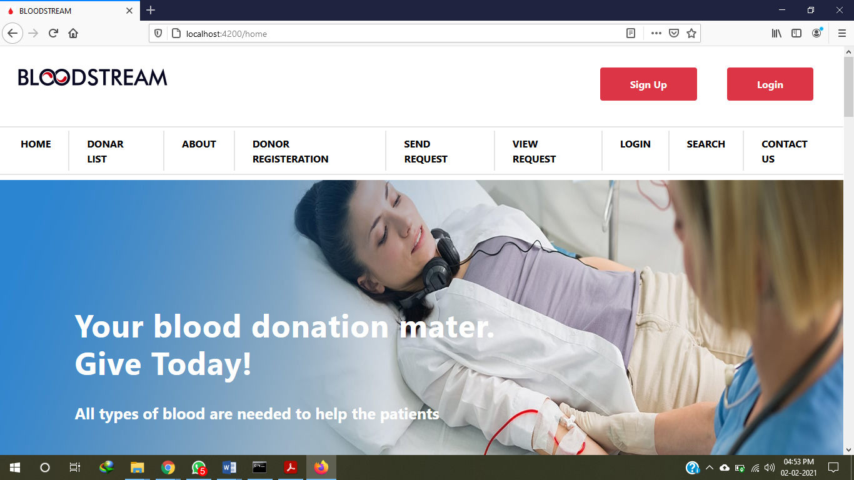

Slide 7
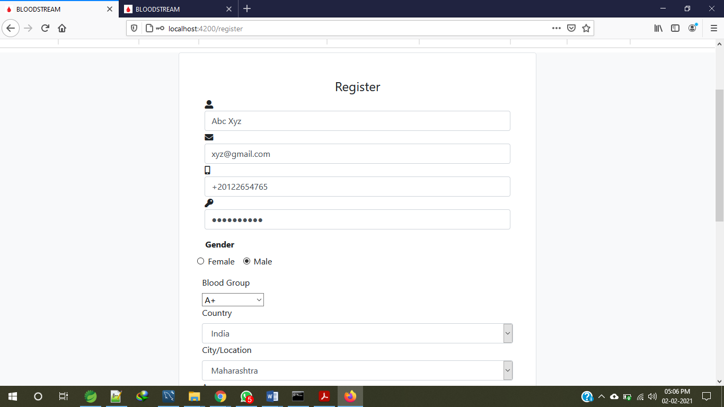

Slide 8
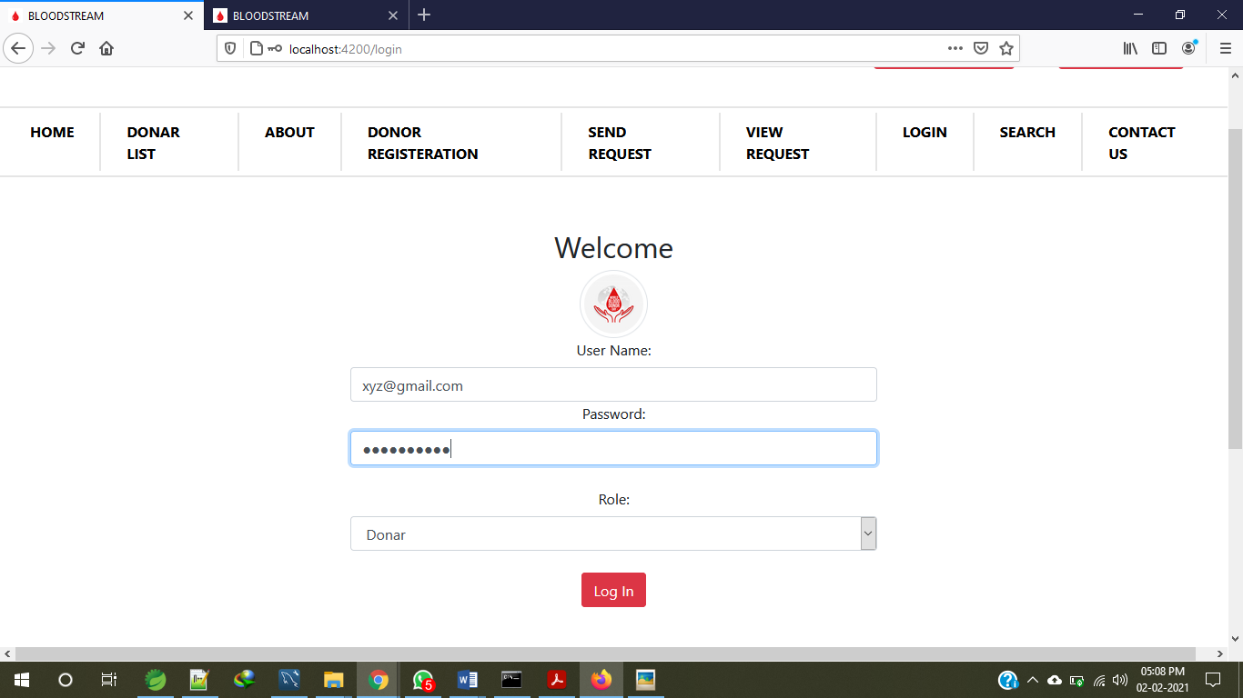

Slide 9
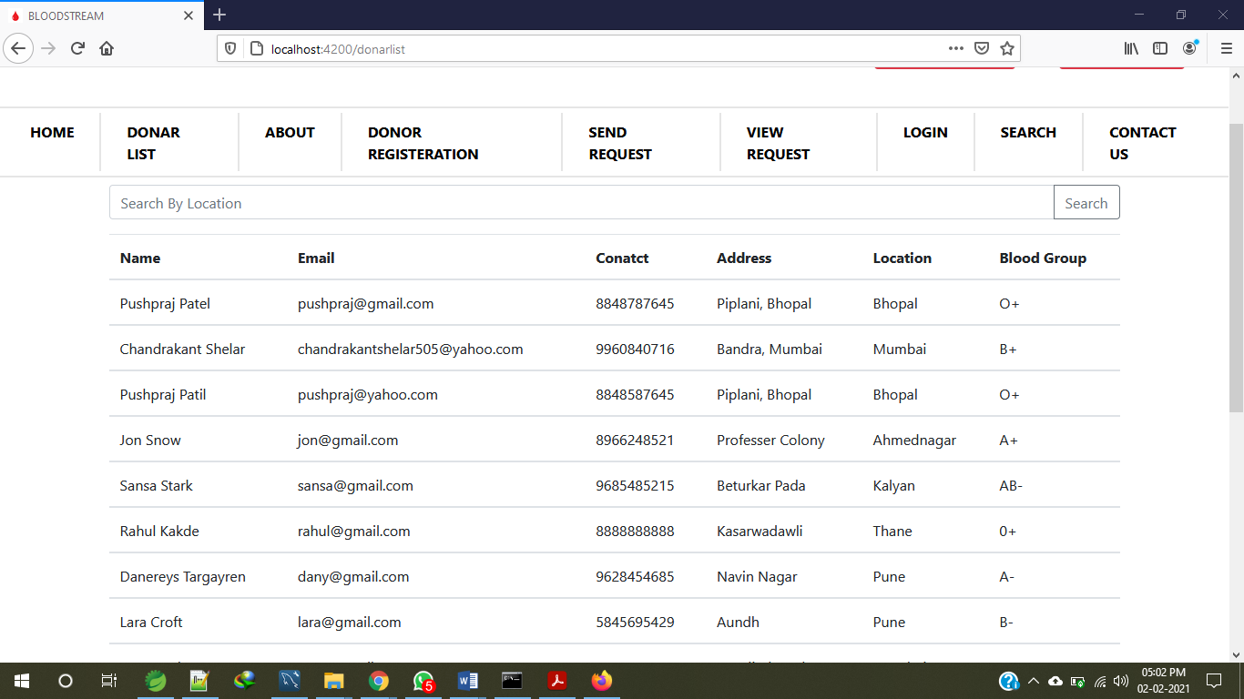

Slide 10
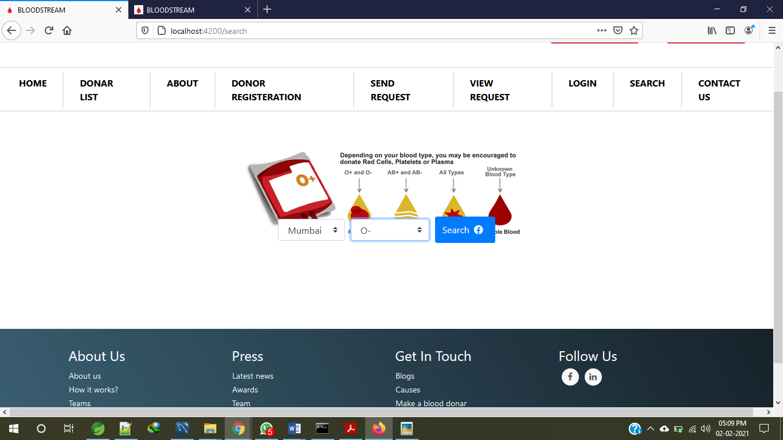

Slide 11
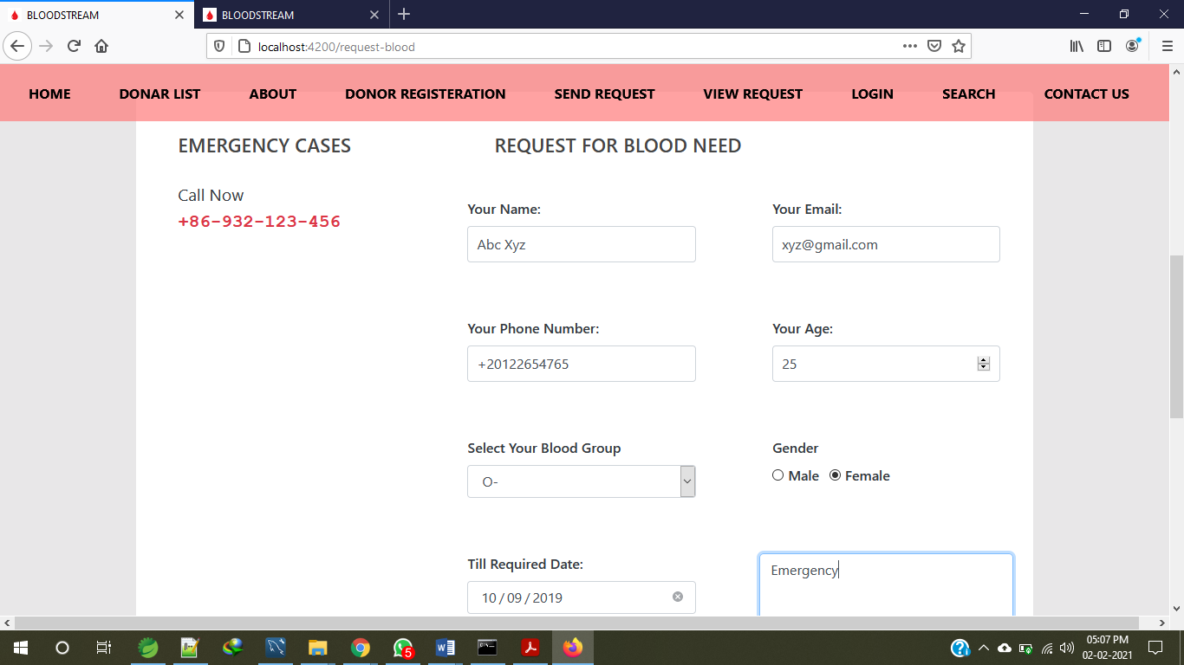

Slide 12
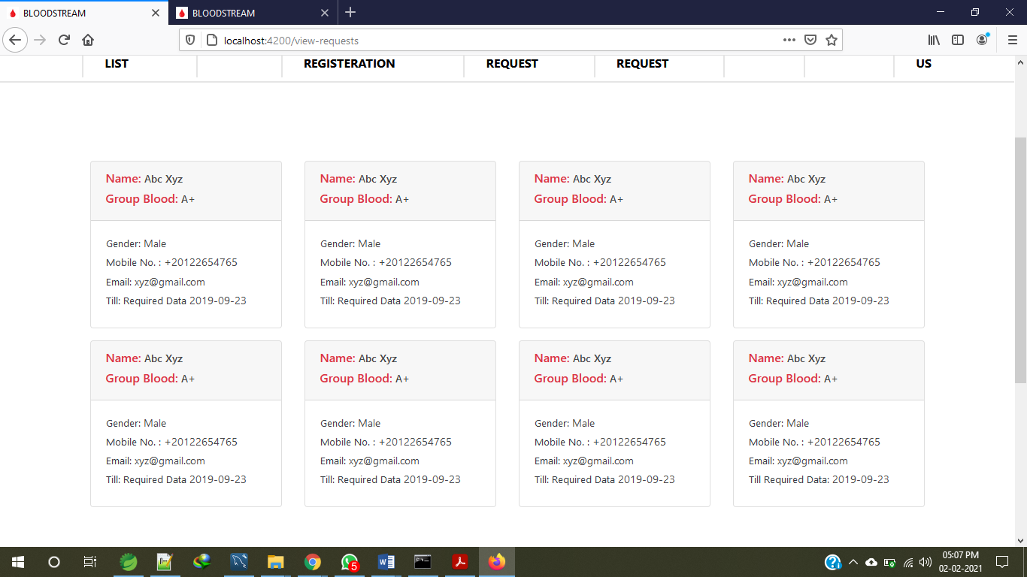

Slide 13
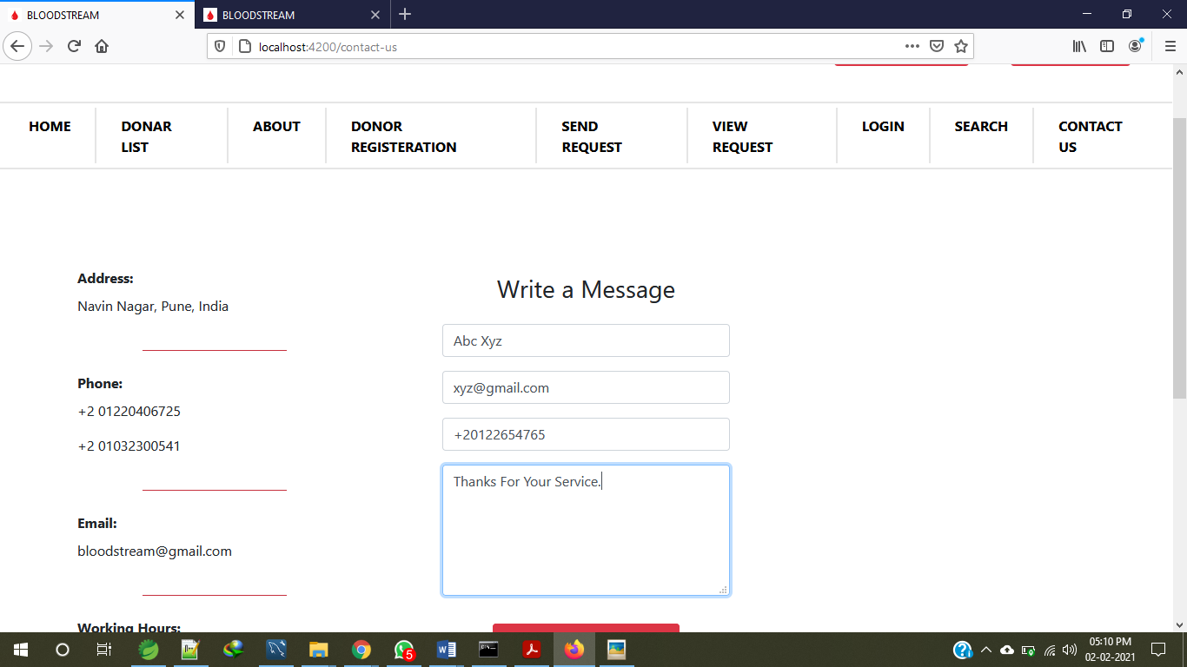

Slide 14
Conclusion
This application reduces the time to a greater extent that is searching for the required blood through blood bank. Thus this application provides the required information in less time and also helps in quicker decision making

Slide 15
References
http://www.redcrossblood.org/learn-about-blood/blood-types
http://www.nhs.uk/Conditions/Blood-groups/Pages/Introduction.aspx
http://www.webmd.com/a-to-z-guides/blood-type-test#1
https://en.wikipedia.org/wiki/Blood_type
https://en.wikipedia.org/wiki/Rh_blood_group_system

Slide 16
Thank You

